Slide 1
Present status and technical directions of the EVN
Michael Lindqvist
Onsala Space Observatory, Sweden
Arpad Szomoru
JIVE, The Netherlands

Slide 2
Outline
Description of the EVN
Present status
Future directions and possibilities
Summary

Slide 3

Difficult to predict the future
The operational performance of the European VLBI Network depends on the effective collaboration of national observatories, the large collecting areas available at those observatories, and its success in incorporating the advances in technology.
Target-of-opportunity capability and e-VLBI operation will contribute to robust and flexible operational procedures. Seamless EVN-MERLIN integration as the short baseline core of EVN can be achieved by adding EVN antennas to MERLIN and connecting the e-Merlin telescopes into the EVN correlator at JIVE.
The increased correlation capability at JIVE of up to 256 Gb/s per radio telescope for routine operations with 32 stations will facilitate innovative research with EVN2015.

Slide 4
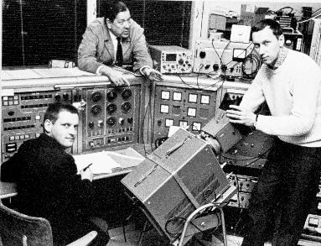
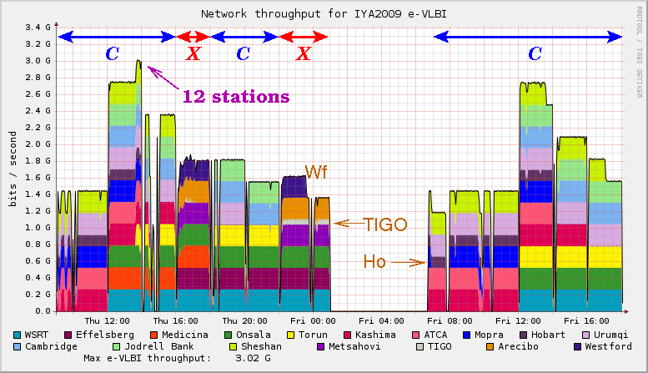
From the 60’s to real-time VLBI
O. Rydbeck
J. Elldér
B. Hansson
First transatlantic VLBI, Onsala, Sweden, 1968
Real-time demo during opening ceremony of IYA,
15-16 January 2009 in Paris

Slide 5
Description of the EVN
The European VLBI Network (EVN) was formed in 1980
  MPIfR (Germany), IRA (Italy), ASTRON (The Netherlands), OSO (Sweden), JBO (UK)
Today it includes 15 major institutes, including the Joint Institute for VLBI in Europe (JIVE)
EVN has no central funding

Slide 6


Slide 7
Description of the EVN
EVN CBD
EVN PC
EVN Scheduler
EVN TOG
A. Zensus
T. Muxlow
A. Gunn
M. Lindqvist

Slide 8
Description of the EVN
EVN CBD
EVN PC
EVN Scheduler
EVN TOG
A. Zensus
T. Muxlow
A. Gunn
R. Porcas
M. Lindqvist

Slide 9
The EVN wheel
Correlation
CBD-meeting
EVN symp.
PC-meeting
EVN schedule
EVN prop.
TOG-meeting
EVN Session

Slide 10
Proposal trend across 9 years
2014 final figures assume
an average of 11 ToOs/year
Muxlow
Introduction of Mark 5 recording system (game changer)
Emergence of high bandwidth optical fibre networks (EXPReS, NEXPReS)

Slide 11
Current status
Maximum Angular Resolution in milliarcseconds
Array | 90 cm | 18 cm | 6 cm | 3.6 cm | 1.3 cm | 0.7 cm
EVN | - | 15 | 5 | 3 | 1 | 0.6
EVN (inc. SH/Ur) | 30 | 5 | 1.5 | 1 | 0.3 | 0.15
EVN+VLBA | 19 | 3 | 1 | 0.7 | 0.25 | 0.13
Telescopes, 14 – 300 m
Data rate 1 Gbps (2x128 MHz, 2-bit sampling)
Global observations @ 1 Gbps
Disk recording/e-VLBI
Digital backends (DBBC2, CDAS, RDBE, R1002, DVP), recorders (mostly Mark 5)
Typically 50-60 Tb/station per session. Record > 1000 TB for a session
Record: A 23−station global experiment.
EVN Software Correlator at JIVE (SFXC)

Slide 12
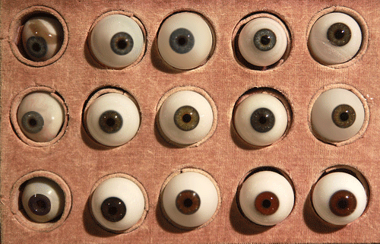
Observing sessions
The EVN observes during:
  3 EVN sessions (3x3 weeks)
  10 e-VLBI sessions (10x24 hours)
  Target of Opportunity
  Out of Session
The VLBI friends performs the observations

Slide 13
Typical EVN Session
Frequency block 1
Network Monitoring Experiment (NME)
(fringe tests)
User experiment
Frequency block 2
Network Monitoring Experiment (NME)
(fringe tests)
User experiment
Calibration
(rxg-file)
Calibration
(rxg-file)
ANTAB-, UVFLG-files
ANTAB-, UVFLG-files
Correlator
Users

Slide 14
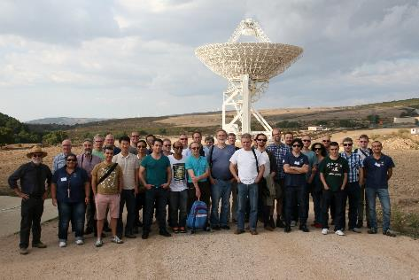
TOG-meetings
Reports from JIVE
  Calibration!
Discussion about previous sessions
Current & new instrumentation
Technical priorities
Reports from NRAO and Haystack
Development: e.g. 64 Gbps with ALMA
SRT, October 5, 2014
CBD

Slide 15
What does the user want?
Average rank | In which direction should the EVN develop?
2.73 | Improved uv-coverage (more telescopes, more short spacings)
3.50 | Increased bandwidth to improve sensitivity
4.57 | Improved calibration in general (phase, amplitude, bandpass, polarization)
4.60 | Improved resolution (more long baselines)
4.73 | Frequency agility for spectral index imaging
6.06 | Real-time e-VLBI capabilities for more telescopes
6.34 | Extended observing time to be able to carry out big surveys
6.42 | Real-time e-VLBI capabilities for a larger fraction of observing time
6.71 | Improved astrometry
6.89 | Larger field of view

Slide 16
Enhancing EVN capabilities
New observing modes
  EVN+LBA
  Out-of-Session (up to a maximum of 144 hours/year)
  Triggered/interrupted e-VLBI observations
  Disk recording and e-VLBI simultaneously (NEXPReS)
    A successful 4 Gbps recording/streaming demonstration was done on September 18, 2013, during the final review of NEXPReS
New telescopes and collaborations
  e-Merlin with all out stations at 1 Gbps (and beyond)
  KVN, RadioAstron, Irbene, SRT, China, AVN, MeerKAT
  Sub-arrays, more observing time with smaller telescopes
  1 APERTIF beam of 12 WSRT dishes added to the EVN
  SKA

Slide 17
Enhancing EVN capabilities
e-VLBI/e-transport
  High speed connectivity to, KVAZAR, KVN, Urumqi, …
  Diskshipping-less operations in the EVN (1 Session – 50-60 TB /station)
  see poster, H. Verkouter
  100 Gbps technology rolled out
  Bandwidth on Demand (BoD) standard to be implemented by NRENs
  Clocks, frequency via commercial networks
Next generation receivers, backends and recording systems
  Broadband receiver 1.6 – 5 GHz (RadioNet3 JRA DIVA)
  DBBC3 32 Gbps (DIVA, next talk by Alef)
  Mark 6, Flexbuff (NEXPReS)
  Observations at 2-4 Gbps (and beyond)
Next generation correlators, SFXC, UniBoard

Slide 18
New observing modes
Triggered/interrupted e-VLBI observations
  Shortening the trigger timescales would be valuable to probe a new transient parameter space in the EVN
  We have (soon) a system in place that can interrupt/trigger a new observation within 5-10 minutes (or so)
  Will open up generic triggered interrupt programmes
  The aim is to offer this mode in 2015

Slide 19
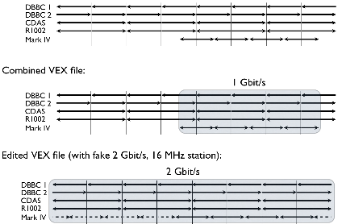
2 - 4 Gbps in the EVN
Mixed mode tests
  Different backends, February 2013
Bottlenecks?
  Disk media
  Field System: (DDC/PFB/FILA10G)
  DBBC2: software (DDC 32 MHz)
  2 Gbps, 2015
Discussion at users meeting
  Which band(s) first? C-, X-, K- and Q-band.
  Science impact?

Slide 20
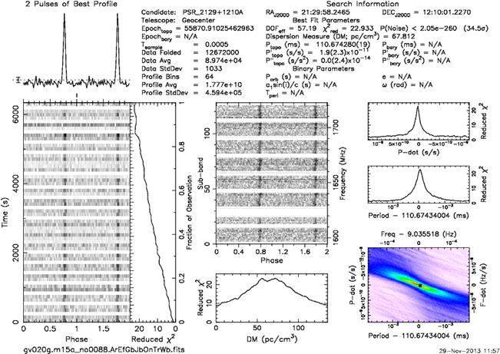
EVN Software Correlator at JIVE (SFXC)
The birth of SFXC - tracking of Huygens probe during descent to Titan
First science project correlated in fall 2011
SFXC primary correlator for disk recorded data since summer 2012
Hardware correlator was closed down 2012
First real-time e-VLBI in December 2012
No MarkIV correlation since then
e-VLBI with 13 stations @ 1 Gbps
Main Features
  Data formats: Mark4, VLBA, Mark5B, VDIF
  Pulsar gating
  Possibility to combine gating and binning
  (practically) Unlimited spectral resolution
  Multiple phase centres (under development, real time)
  Phased array mode (see EVN Newsletter #37, January 2014)
See Poster, M. Kettenis

Slide 21
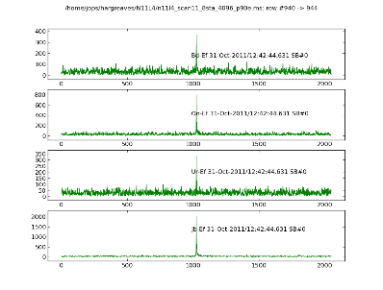
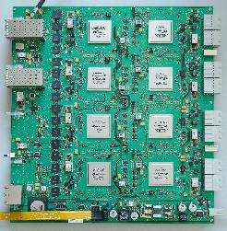
JIVE UniBoard Correlator (JUC)
UniBoard: EC-funded, led by JIVE
  JRA in RadioNet FP7 (also in RadioNet3)
  Create generic, high performance computing platform for radio astronomy
  FPGA
  One board roughly equivalent to the MarkIV correlator
  Real results
  Close to commissioning

Slide 22
SXFC vs JUC
Software:
Fantastically flexible
“Easy” to modify, improve, extend, expand, upgrade
Hardware gets cheaper as time goes by
Development effort and the effort needed to make it into an operational system grossly underestimated
Definitely not suited for heavy lifting
~13 stations on current SFXC cluster at 1 Gbps
16 stations at 4 Gbps: factor of ~5 more hardware needed
FPGA:
Once it works, it goes like the clappers
Perfect for “simple” operations
Not nearly as flexible
Hard(er) to develop/debug/modify/upgrade firmware
16 stations on 2 available UniBoards at 2 Gbps
4 Gbps: factor 2

Slide 23
Summary
Development can come either bottom-up (new technology looking for astronomical uses) or top -down - (defining astronomical problems first and finding technical solutions afterward). EVN does both.
Communication and scientific interaction between engineers and scientists involved in the development and operation of radio astronomical instruments, such as the EVN, is very important.
EVN is making use of and drive technical progress
The future for the EVN is looking bright and it will complement the SKA

